Slide 1
Cyber Security
Name
Institution
Date

Slide 2
Defense Industrial Base sector (DIB)
It was established under Department of Defense (DoD).
Its cyber security program protects DoD’s information and data in classified and unclassified networks and information systems
There is sharing of information and data among service providers and the governemt
Notes:
Defense Industrial Base sector (DIB)
DIB is a sector under Department of Defense. It has cyber security program which aims at enhancing and supplementing DIB capacities to protect DoD’s information and data which resides on and transports unclassified networks and information systems. The program is a partnership between private and public sector designed to increase network defenses, eliminate damages experienced in critical programs and improve the sector’s situational awareness. In this program, classified and unclassified information and data is shared among participants on threat assessment and information.

Slide 3
Challenges
1. Long supply chain
Different companies from different countries are used to supply cyber security services
They can easily be subjected to manipulation.
Intellectual property is at risk through cyber theft
Development in cyber research requires generations to be developed.
Notes:
Long supply chain: Defense sector has long supply chain systems for building modern weapons which stretch to companies in different countries which may subject them to cyber manipulation. As a result, developers and innovators of cyber security systems in this sector are experiencing a challenge of intellectual property theft via cyber espionage (Internet Security Alliance, 2019). Additionally, research development requires generations to fully develop making investment and innovation of weaponry expensive.

Slide 4
Challenges continued
2. It is labor intensive
Development of cyber security network for such a huge organization requires a lot of labor.
The long supply chain requires critical attention to clear any possibility of threats.
Partnering of private and public sector ensures division of roles and responsibilities.
Notes:
It is labor intensive: in DIB’s framework, the process of collaboration in codified and for the agreement to be successful, it requires a lot of labor. The supply chain is long and easily attacked by cyber threats. As a result, finding partners with well developed cyber systems with no loopholes for cyber attacks is challenging; a reason why companies must partner to provide quality services.

Slide 5
Challenges continued
3. Confusing requirement in sharing information
Requirements on information sharing diverge from security measures to compliance
New regulations are established often, increasing cost of operation
Compliance and security measures cannot be compared and one should not be treated as more important than the other
Notes:
Confusing requirement in information sharing: In cyber security, sharing of information has requirements which are confusing, thereby diverting resources from security measures to compliance. New regulations are established regularly, leading to a significance increase in cost of doing business with the government. Cyber security focus has shifted from incentives to compliance with standards provided for in Executive Order 13636 (Dwyer, 2019). It is important to note that compliance alone cannot guarantee security and has nothing to do with security measures, and therefore, it should not be confused with security.

Slide 6
Challenges continued
4. Coproduction is required in USA along the value chain
It leads to increase in demand and the need for suppliers to provide the services
Policies are formulated to guide information sharing
The policies have many demands which are costly to comply with
Notes:
Coproduction is required in USA along the value chain. According to Dwyer (2019), when coproduction demand rises, the need for defending network of suppliers increases too, leading to policy in defense sector. Such policies includes those that guides information sharing among companies from different countries and rules of Defense Federal Acquisition Regulation Supplement guiding on methods for safeguarding defense information. The policies pose a challenge to foreign companies making it impossible to comply with imposed standards by the DoD. Inland defense companies are left at a crossroad of choosing between proceeding with a foreign supplier who lacks compliance standards or failing to comply with contractual offset requirements.

Slide 7
Challenges continued
5. It is expensive and difficult to maintain
Cyber security policies favor USA-based companies more than foreign countries
US and non-US frameworks were developed to address the needs for US and foreign nations
Policy laws makes it difficult to accomplish information sharing
Unification of companies is difficult due to many policies
Notes:
Cyber security is expensive and difficult to maintain. DIB cyber security policies tend to favor USA-based companies providing cyber security services in USA. When there was reduction of spending in defense sector, many companies expanded their operations in USA to create diversity in cyber security. Later, there was development of International Trafficking in Arms Regulations made the defense sector to establish two distinct networks; for US employees and for non-US employees (Internet Security Alliance, 2019). As a result, unification in cyber defense companies becomes difficult. Privacy laws also pose a challenge in establishing unified monitoring environment.

Slide 8
Benefits of Cyber Security in Defense Industrial Base sector
1. Protecting critical infrastructure
Through research and development of military weaponry systems
It enhances protection of infrastructure in Department of Defense
Sharing of data improves security through curbing threats to security
Government systems are protected through infrastructure and network design to make them more resilient
Notes:
Benefits of Cyber Security in Defense Industrial Base sector
Protecting critical infrastructure:
Cyber security is designed to enable research and development of military weaponry systems and subsystems used to enhance protection of infrastructure in Department of Defense. DIB cyber security system is considered as an industrial complex which enables research and development, design, production and maintenance of military weapons systems (Corrin, 2016). Data is shared between government and DIB to elevate security systems in defense against threats. Sharing of the information ensures protection of government systems which have experienced the worst security threats, through architectural and network designs, making them more resilient.

Slide 9
Benefits
2. Closing malicious loopholes
It combats counterfeit plans in the supply chain system
Compromised systems are discarded to prevent them from compromising operations
Risk management is easily achieved
Notes:
Closing malicious loopholes
Cyber-focused military has contributed to combating of counterfeit plans in the supply chain (Corrin, 2016). Some parts of the system are compromised, and thus, mission to prevent them from reaching the troops is conducted to prevent potentially malicious programs and weapons. The problem is in increasing complexity of new technology which is being expanded to the military, making its missions IT reliant. Through cyber security systems, risk management in the supply chain is easily managed by the Defense Information Systems Agency.

Slide 10
Benefits
3. It helps in building alliances and coalitions
Public and private companies establish partnerships and relationships.
Inland and foreign countries are used to establish strong cyber security systems
Strong networks which are resistant to cyber threats are developed through the partnerships
Notes:
Alliances and coalitions are built
Public and private companies establish partnerships. DoD through DIB engages companies from USA and abroad to improve and install cyber systems, leading to establishment of allies who can face threats together. Companies help each other to understand the system better to build stronger networks which are resistant to cyber threats. These partners help in building a wide cyber security environment with defensive capacity.

Slide 11
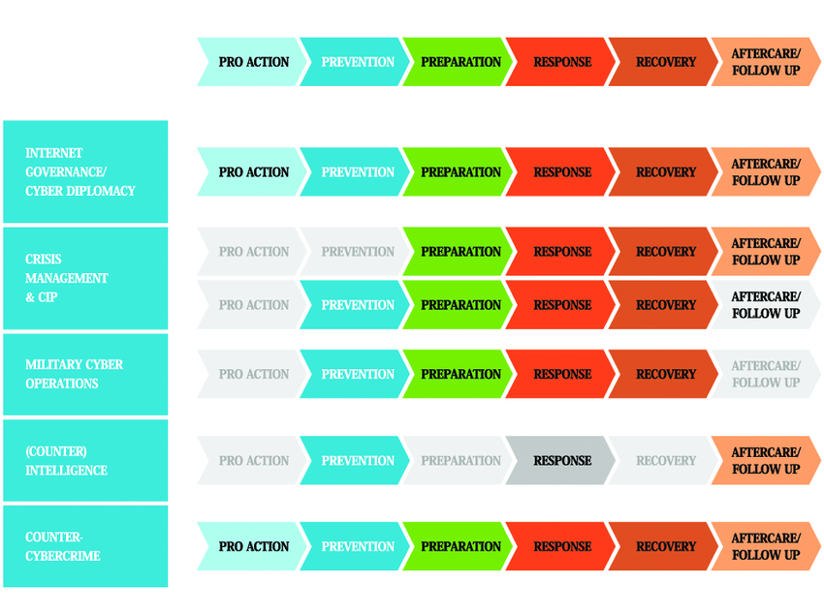
Cyber Security Diagram

Slide 12
References
Amber Corrin (2016). Defense Industrial Base: Protecting the nation's protectors. Federal Times. Retrieved on March 2, 2020 from https://www.federaltimes.com/smr/critical-infrastructure/2016/07/18/defense-industrial-base-protecting-the-nation-s-protectors/
Internet security alliance. (2019). Defense Industrial Base: Cybersecurity. Retrieved on March 2, 2020 from https://isalliance.org/sectors/defense-industrial-base/
Morgan Dwyer (2019). A Commentary: Does the Defense Department’s New Approach to Industrial Base Cybersecurity Create More Problems Than It Solves? Centre for Strategic and International Studies. Retrieved on March 2, 2020 from https://www.csis.org/analysis/does-defense-departments-new-approach-industrial-base-cybersecurity-create-more-problems-it

